Slide 1
Mapping a Texture to an Object

Slide 2
Different modes
So the idea is that you take a canvas, an object and you can (depending on what you want) variously set how a texture (picture) is projected onto that object
Note that if you’re building the tools that do this, you may need to also work in reverse, that an artist draws something with art on it, and you need to spit out the geometry and the texture

Slide 3
Image Processing theory
Today isn’t the theory of image processing.
Image processing (which will sort of come up in the next couple of weeks) is the overall theory of how to sample a texture, how to store textures etc..
Today we’re just going to map an image to a texture to an object.

Slide 4
Texturing
Simply, the process of texturing is loading up an image as a texture, and then projecting it onto a 3D model (usually you apply it to a surface)
Note that images are in raw bitmap format, and, for now must be square and powers of 2 in dimensions (256x256, 512x512 etc). That’s an old contrivance, but isn’t a huge barrier for us.

Slide 5
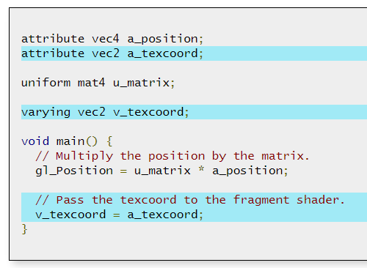
Vertex Shader – Pass in the Texture Coords
Notes:
Note my code is slightly different for formatting reasons but it’s good enough

Slide 6
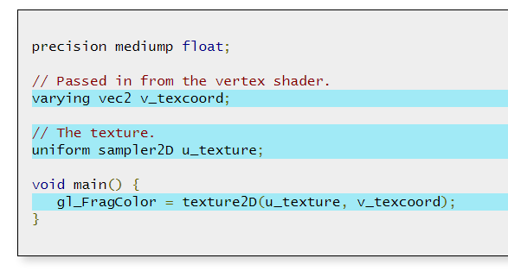
Fragment Shader

Slide 7
Fragment Shader
That is a uniform 2D sampler (there are other more sophisticated samplers that don’t do us any good for this demo)
We take the texture coords from the vertex shader, and just look up the texture data straight from the texture, using texture2D
Again, this is the simple form, we could use more sophisticated samples

Slide 8
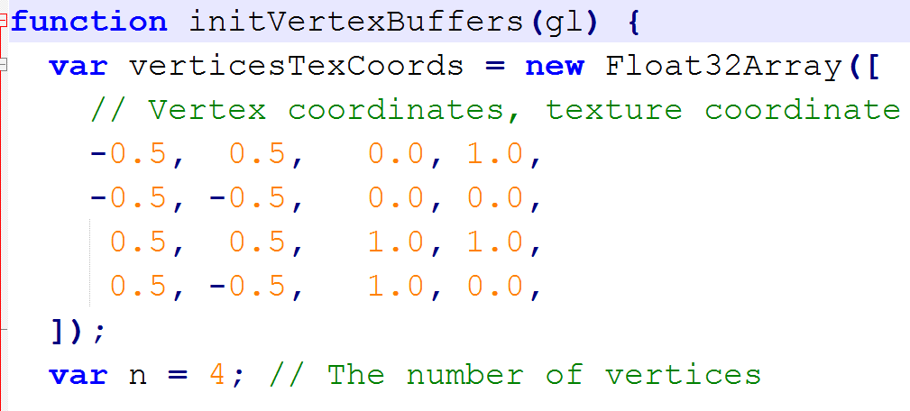
Set the coordinate mapping

Slide 9
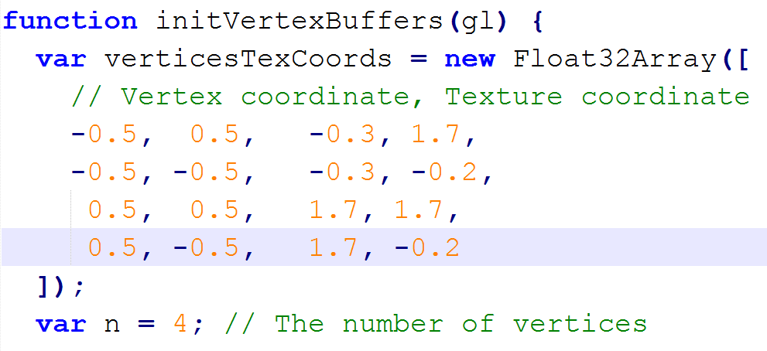
Other Coordinate Mapping (For repeat and mirror)

Slide 10
Some quick theory
More on this next week
Using a texture coordinate greater than one sets how many times it repeats as it’s tiled across the surface if it’s set to mirror/repeat mode

Slide 11
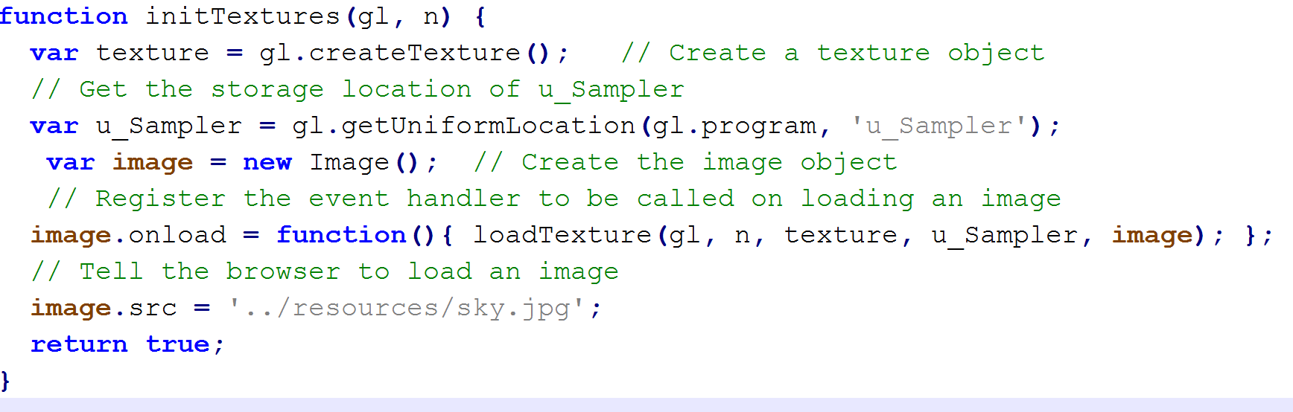
Initialize the Texture (that can be loaded)
Note: I’ve stripped out some error handling from the code I’m giving you

Slide 12
Also, Screw You Chrome!
Notice that img.src = …..
That is blocked by chrome (and firefox but FF is easier to workaround) basically it’s because what we’re doing is considered cross server
Solutions
a) Call chrome with --allow-file-access-from-files in the command-line.
b) Run a webserver locally to supply the textures for Chrome.
c) Use Firefox for examples with textures stored on the local filesystem.
Thus far I think this is just a problem for today, because in trying to make things simple some stuff is behaving in an ‘insecure’ way.

Slide 13
For Firefox, the equivalent parameter, set via about:config, is security.fileuri.strict_origin_policy, which should be set to false. Remember to set it back when you’re finished because you open a security loop-hole if local file access is enabled.

Slide 14
Coordinates
Image coordinates have +x to the right, +y as down (so bottom right quadrant)
WebGL (and Open) wants them in coordinates s, t with x as the positive x direction and t as vertical (upper right quadrant)
So you end up with a gl.pixelStorei(gl.UNPACK_FLIP_Y_WEBGL, 1); line, for every texture.
It should be perfectly obvious why this is a sensible thing to do for every single texture you ever have. /s

Slide 15
Texture Wrap Modes
We actually set how it’s drawn with a command
Gl.texParamater
(specifically we use gl.texParameteri(gl.TEXTURE_2D,....)
We are content to stick with a TEXTURE_2D for now, but there are other kinds of textures (and texture formats) that we could use

Slide 16
Wrap Modes (second parameter)
The 2 we are interested in Today are
GL_TEXTURE_WRAP_S, GL_TEXTURE_WRAP_T
Which wrap around in the S and T direction,
This parameter would also let us mini or magnify a texture with gl.TEXTURE_MAG_FILTER (or _MIN_), mag stretches it to fill the screen, min shrinks it to fill the screen.
Note: the minification filter defaults to requiring a texture format you don’t typically use in WebGL so if you try and it doesn’t work, that’s why

Slide 17
3rd Parameter
The third parameter depends on the second,
So for a plain textured quad gl.TEXTURE_MIN_FILTER, gl.LINEAR is how we’re going to leave it
For the GL_TEXTURE_WRAP_S (or T) we have choices
GL_CLAMP_TO_EDGE
GL_CLAMP_TO_BORDER
GL_MIRRORED_REPEAT
GL_REPEAT // this is the default
GL_MIRROR_CLAMP_TO_EDGE

Slide 18
Math?
There’s some math about what exactly each of those parameters does, but we’ll save that for a theory discussion

Slide 19
Changing your code
The difference between wrap modes

Slide 20
NPOT (not power of two)
This is one area WebGL and OpenGL differ a bit
OpenGL has support for not power of two texture sizes, OpenGL ES and WebGL do too, but only for certain filtering modes, etc.
We’ll leave that discussion for another time. For now, stick to power of 2 texture sizes. (or try something else and see what happens)

Slide 21
Lab for Today
I’ve given you a directory, in it there is a TexturedQuad.js file, a TexturedQuad_Repeat and a TexturedQuad_Clamp
1. Take the first TexturedQuad.js, make a copy along with it’s HTML. Now make it do what the other two do (you only need to change the texture parameters and the coordinate mappings from vertex cords to texture cords)
https://www.diffchecker.com/diff might make this super easy.
Oh and make a texture and replace the “sky” one that’s in the lab.

Slide 22
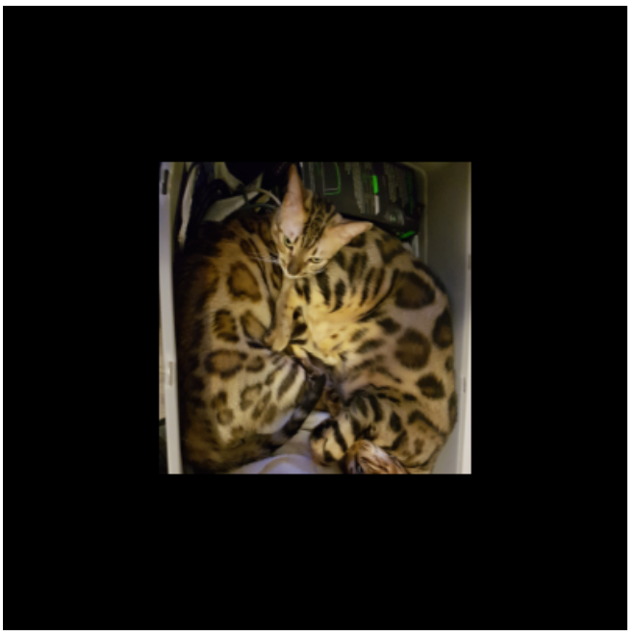
e.g.

Slide 23
End of Lab
Make sure you set the firefox flag
security.fileuri.strict_origin_policy back to true

